Slide 1
E-Commerce with watsonx.data and Open Table Formats
Netra C N

Slide 2
watsonx.data and Open Table Formats
Centralized Catalog/Metastore
At the core of watsonx.data is a centralized catalog/metastore that supports open table formats
Delta Lake
Apache Hudi
Apache Iceberg
Why These 3 Formats Are Critical in a Lakehouse
Delta Lake: Ensures real-time analytics with ACID transactions and schema enforcement.
Apache Hudi: Enables incremental updates for fast-changing data.
Apache Iceberg: Efficient querying and long-term storage for historical data.

Slide 3

Business Use Cases
Financial Services
Real-Time Detection: Fraud prevention (Delta Lake).
Fresh Data: Incremental portfolio updates (Hudi).
Secure Storage: Compliance reporting (Iceberg).
Healthcare
Fresh Updates: Patient record synchronization (Hudi).
Timely Predictions: Predictive analytics (Delta Lake).
Compliant Storage: Long-term audits (Iceberg).
E-Commerce
Real-Time Operations: Inventory updates (Delta Lake).
Deep Insights: Sales trend analysis (Iceberg).

Slide 4
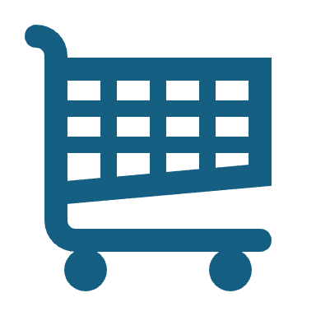
E-Commerce Use Case Implementation

Slide 5
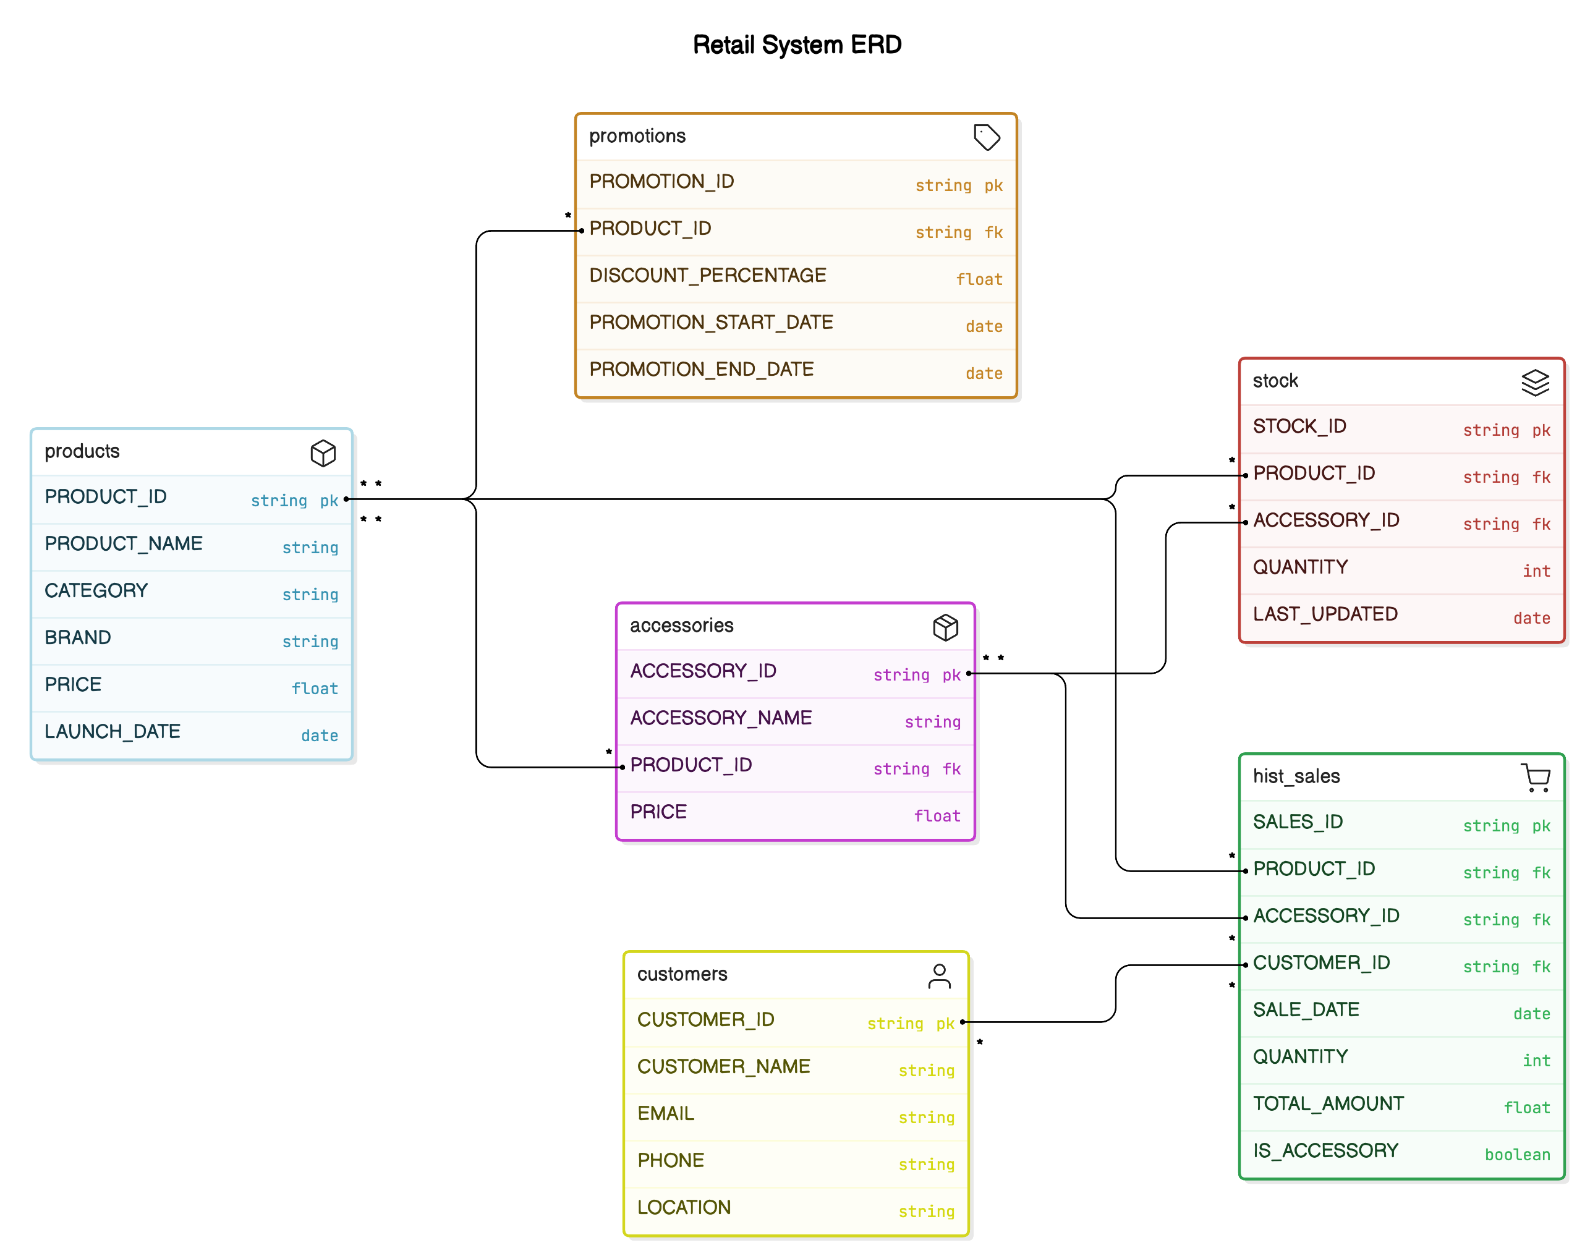
Entity-Relationship Diagram.

Slide 6
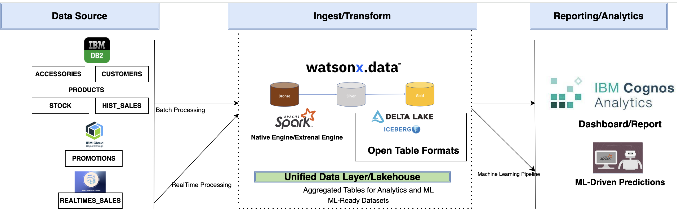
Reference Architecture

Slide 7
Data Tables and Structure
Table Name | Data Source | Purpose | Storage Type
Products | DB2 | Stores product details and metadata for current products | DB2
Customers | DB2 | Tracks customer details and behaviour (real-time and historical) | DB2
Accessories | DB2 | Stores accessories details and metadata for current accessories | DB2
Hist_sales | DB2→ (wxd) | Historical sales data | Iceberg
Realtime_Sales | Realtime code→wxd | Current real time sale generated through a python code | Delta lake
Stock | DB2 | Stock data for products and accessories | Db2
Promotions | DB2 | Promotions related to products | IBM COS

Slide 8
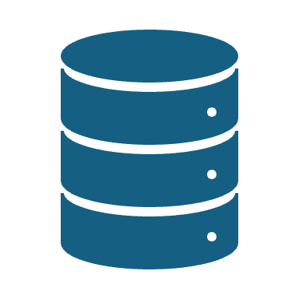
Iceberg and Delta Lake Integration
Key Files and Functions:
Iceberg Data Load
Manage Bronze, Silver, Gold layers with Spark.
Ingest DB2 and CSV data into Bronze.
Transform and aggregate in Silver and Gold.
Realtime Data Load Generator
Simulate real-time sales ingestion into Delta Lake Bronze.
Delta Lake Data Load
Process promotions, sales, and recommendations across layers.

Slide 9
Data Ingestion and Federation Functions
Sales Trend Analysis and Product Predictions
Customer-Specific Product Recommendations
Sales Data Aggregation and Product-Level Sales Insights
Targeted Promotions and Recommendations

Slide 10
Analytics with Cognos and Watsonx.data Integration
Why Integrate Cognos with Watsonx.data?
Streamlined Analytics: Access large datasets directly from Gold layer tables.
Actionable Insights: Build custom dashboards and reports tailored to business needs.
Real-Time Decisions: Leverage real-time and historical data for improved performance tracking.
Key Integration Steps:
Set Up Connection: Configure Cognos to connect to Watsonx.data, enabling access to Gold layer tables.
Access Business Data: Use metrics like sales trends, inventory levels, and customer behavior for analysis.
Create Dashboards and Reports: Design interactive dashboards, such as:
Product Profile Dashboard: Analyze sales trends and predict future performance.
Customer Segmentation Dashboard: Identify customer groups for targeted strategies.
Inventory Management Dashboard: Optimize stock levels with demand forecasts.
Explore the potential: Transform data into actionable insights to make smarter, data-driven decisions.

Slide 11
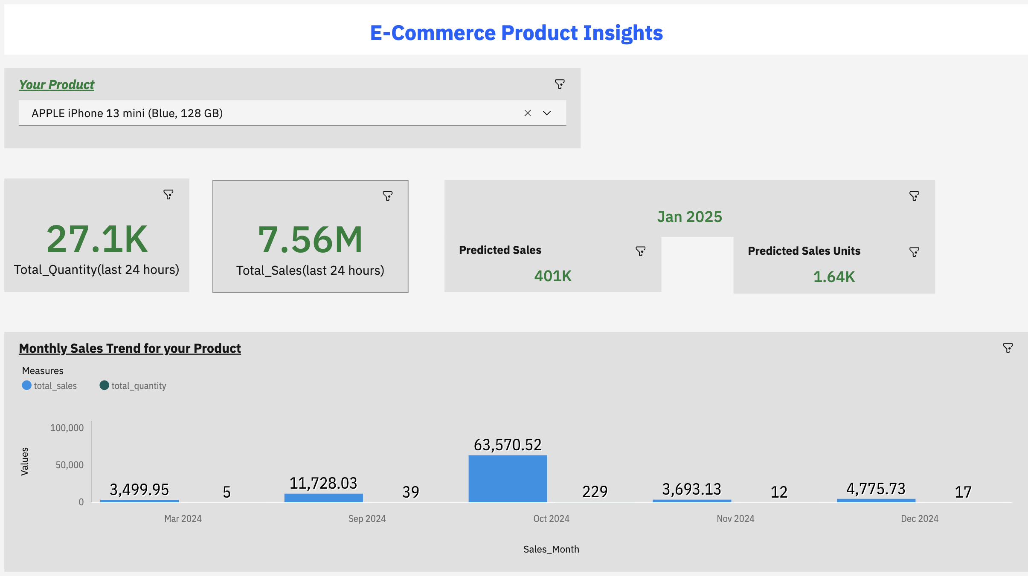
Product Profile Dashboard

Slide 12
Thank you

